Slide 1

Project 3 – Is It Real or Fake News
Matthew Belesvski
Christy Wang
Sherry Javed

Slide 2

Proposal of our Project
To find out if the News published on the website are “Real” or “Fake”

Slide 3
Final Project Requirements:
Technologies learned and used in our project:
Logistic Aggression
Python Pandas
HTML/CSS
Tableau
Hosting application using Heroku tool.

Slide 4
Datasets
Fake and real news dataset – Kaggle.com
https://www.kaggle.com/clmentbisaillon/fake-and-real-news-dataset?select=Fake.csv
Github repo with headlines from r/nottheonion and theonion.com
https://github.com/lukefeilberg/onion/blob/master/OnionOrNot

Slide 5
Cleaning the data
Use of pandas to:
Import the Real and Fake news csv files from Kaggle into dataframe
Real News = 1
Fake News = 0
Import OnionOrNot csv into dataframe and swap the 0 and 1 values to match our system
Combine both dataframes into one dataframe

Slide 6
Machine Learning
Removal of stop words
Train Test Split – 75-25 split
Count vectorizer to create matrix of counts for each word in headline
Use of Logistic Regression
Tested our model using Area Under Curve (ROC_AUC) which gave us 94% accuracy
Save model and count vectorizer for use on the website

Slide 7
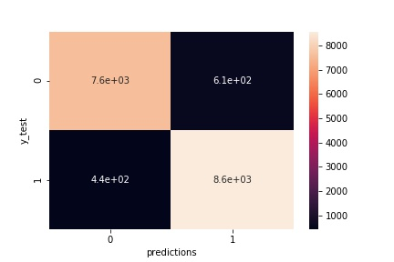
Machine Learning – Confusion Matrix
Actual
(7600)
(610)
Actual
(440)
(8600)

Slide 8
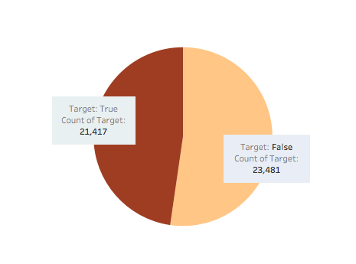
Data Exploratory ﻿Number of Fake news vs. True news (Output from Tableau)
Nearly balanced dataset

Slide 9
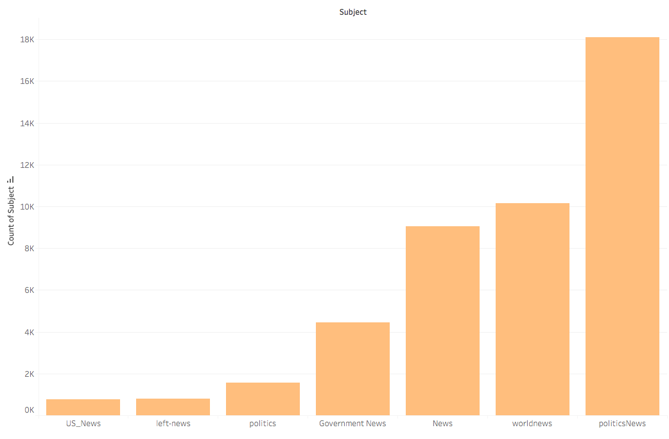
Data Exploratory ﻿ ﻿News Categories Counts (Output from Tableau)
Politics news dominates one third of the datasets

Slide 10
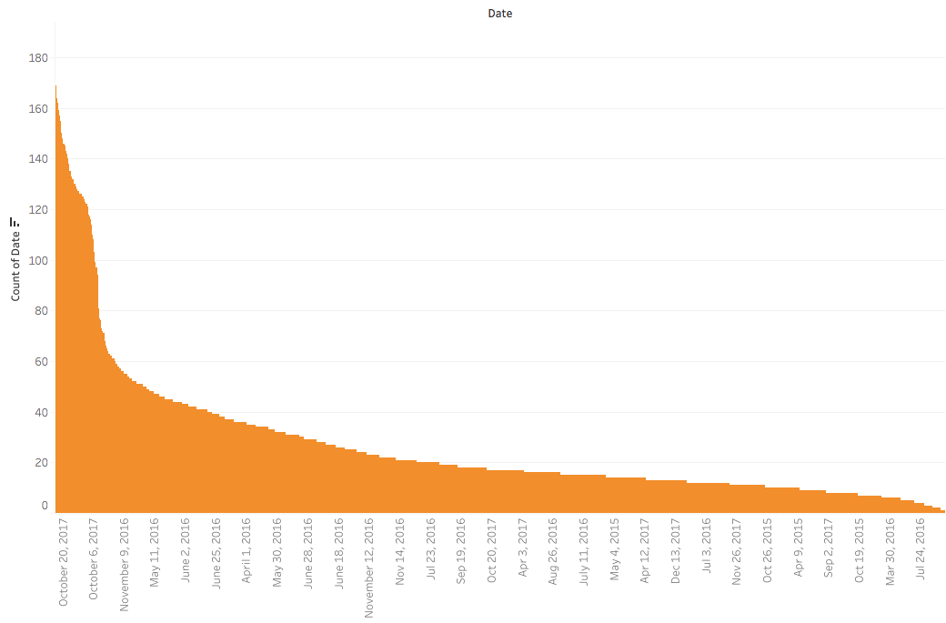
Data Exploratory ﻿ ﻿﻿Count of Dates (Output from Tableau)
News are mainly between 2016-2017

Slide 11
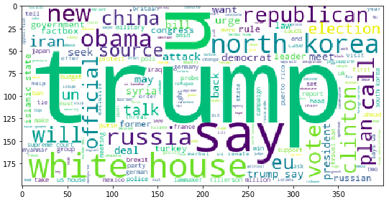
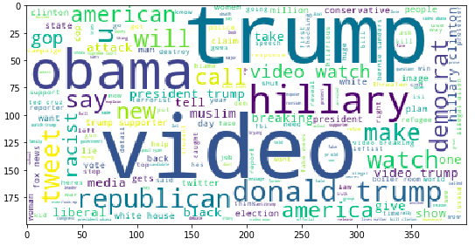
Data Exploratory ﻿ ﻿﻿Word Clouds (Output from Python)
Frequently used words in title for True News
Frequently used words in title for Fake News

Slide 12
Let's head towards our Practical demonstration

